Slide 1
Integration for Research Literature Bibliographic Data
Chachithanandhini Bodipalayam Kalyanasundaram [3469240]

Slide 2
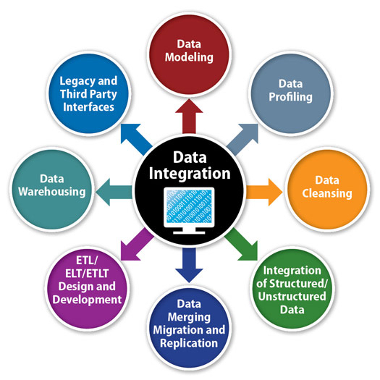

Introduction
In this data integration project, I consider the task of integrating research literature bibliographic data from different source formats.
The attributes from each source are resolved for heterogeneity and finally integrated into a single schema.
Image Sources: https://research.aimultiple.com/data-integration/ and
https://www.datamation.com/big-data/data-integration-use-cases.html

Slide 3
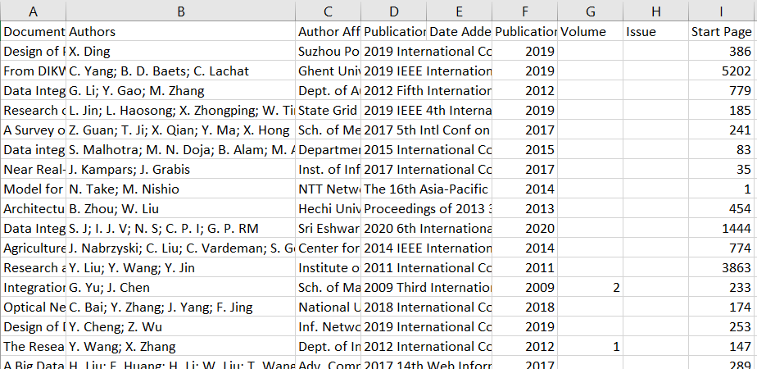
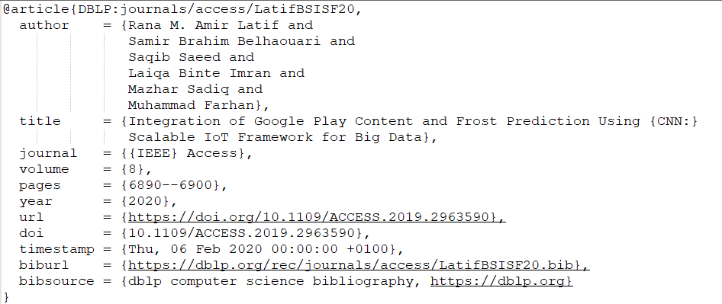
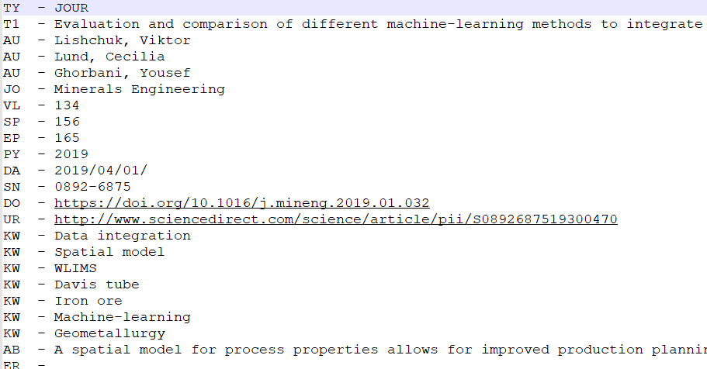
Data Source
IEEE, containing bibliographic data in CSV format
DBLP, containing bibliographic data in BibTex format
ScienceDirect, containing bibliographic data in RIS format

Slide 4

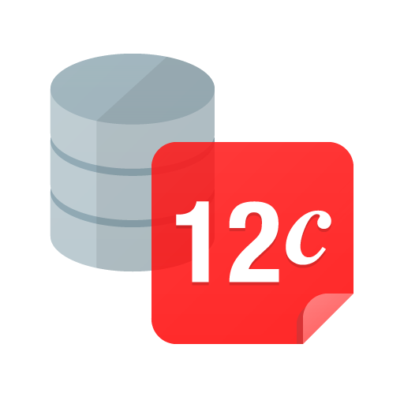
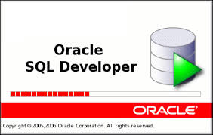
Implementation
I first implemented a set of wrapper classes for the different source files. The wrappers handle constraint checks and resolve structural heterogeneity for different source data types.
A mediator class is implemented to integrate the output of the wrapper classes. It also resolves semantic heterogeneities present in the data, such as name, identity and value conflicts.
Technical Implementation
Java
Oracle 12C

Slide 5
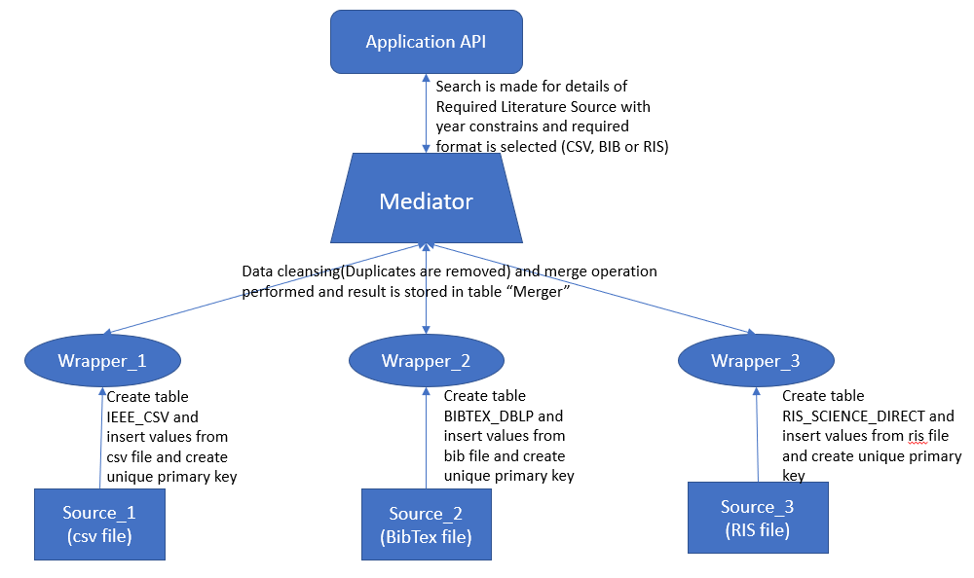
Design

Slide 6
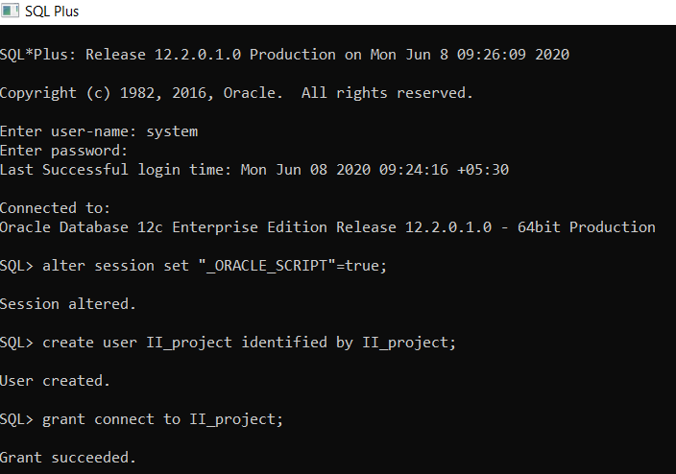
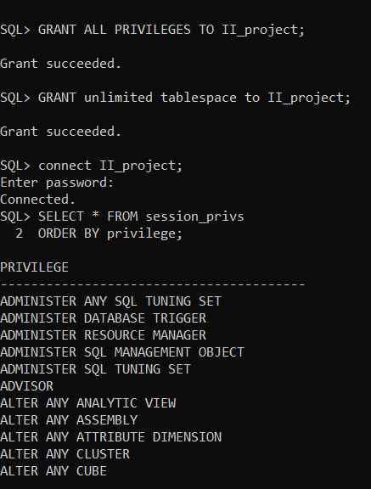
Schema Creation

Slide 7
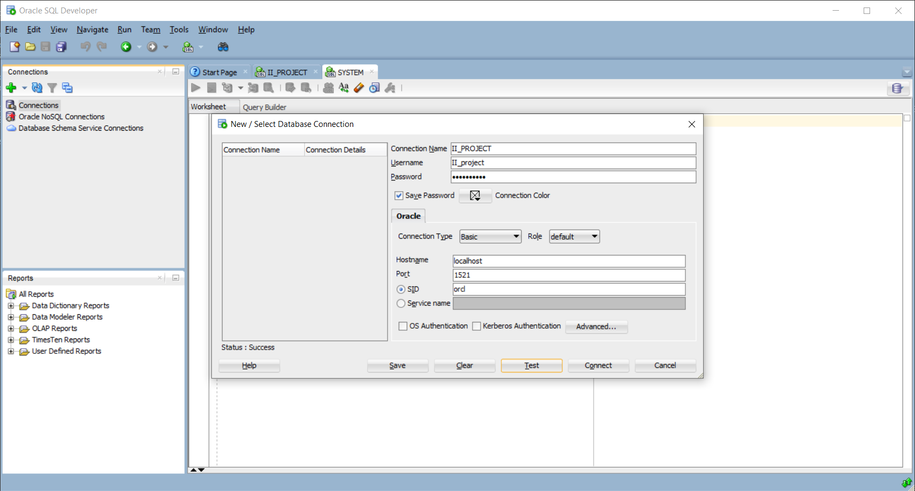
Connection Establishment in SQL Developer

Slide 8
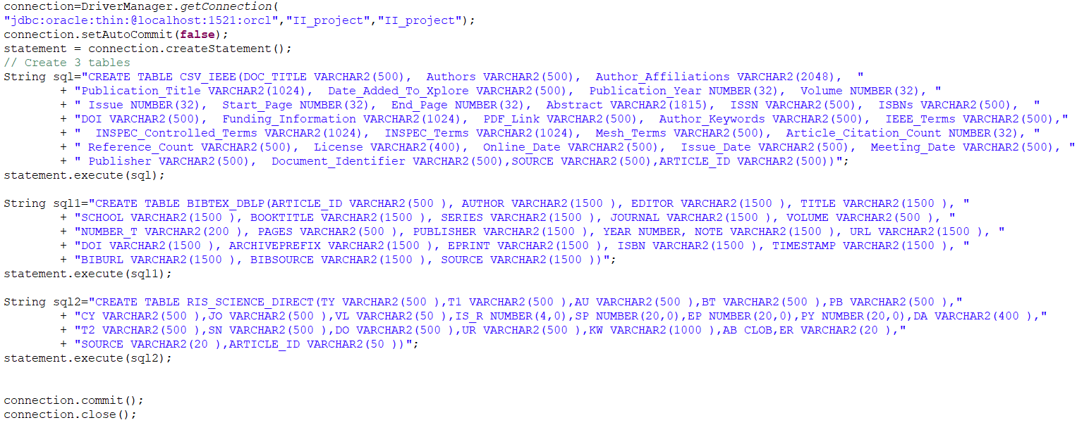
Creating Table

Slide 9
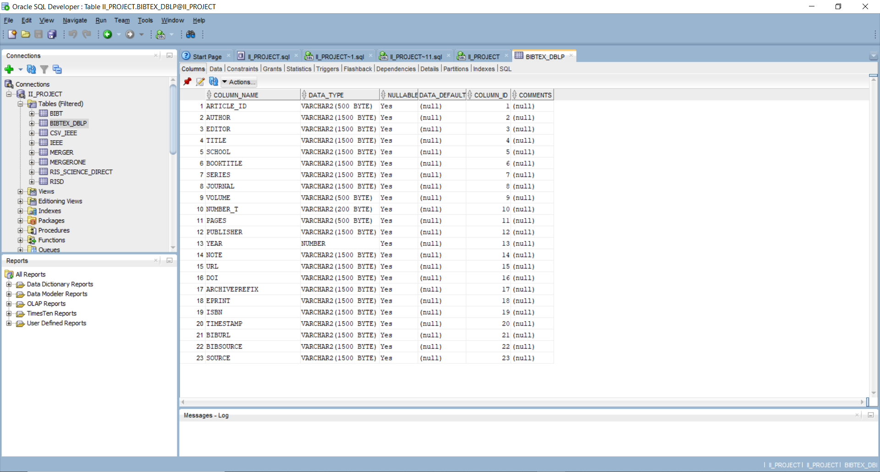

Slide 10
Creating wrapper class and key generation
Extract multiple authors name to generate key(Article_ID) such that:
First author's last name + other authors' first letters of their last names + year of publicatio
Insert Data from all three sources into corresponding tables without any data modification or data loss.

Slide 11
Resolving Heterogeneity
During insertion into RIS table, Author names are split and last name is added after the first name.
Also, Author names from multiple fields are extracted and inserted into a single cell in our relational database.
On CSV insertion, Author names split by semi-colon are replaced with “and” so that a common format is achieved as that of bib, thus resolving semantic heterogeneity.

Slide 12
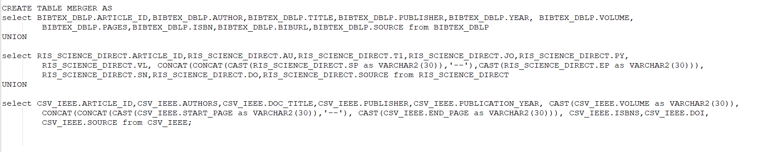
Merge query for Mediator Implementation
Required fields from all three data sources are merged and rendered as one single relation called ”Merger”

Slide 13
Here data-model heterogeneity resolved by:
1) casting the types of columns like: Volume, Start Page, End Page
2) Concatenation to render ‘Start Page’ and ‘End Page’ of RIS format into ‘Pages’ specified in BibTex format.

Slide 14
Duplicate Detection and deletion
From resulting Merger table, duplicate rows are detected and deleted with help of “rowid” in SQL such that:
DELETE FROM MERGER WHERE rowid not in (SELECT MIN(rowid) FROM MERGER GROUP BY ARTICLE_ID, TITLE);
Hence, the single Integrated Schema without duplicates “Meger” is created with Article_ID as its primary key.

Slide 15
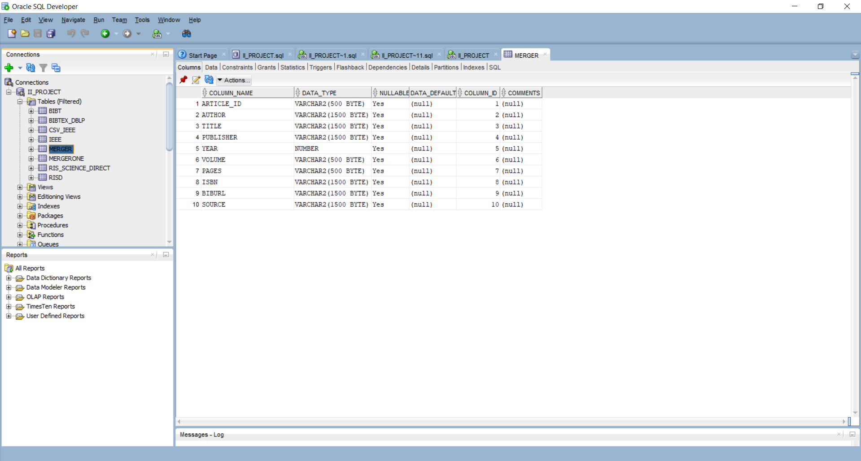

Slide 16
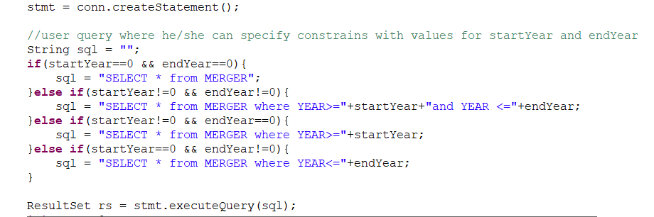
Output Generation
User can generate output in any of the three formats RIS, CSV or BIB, with required constrains. Here we have modeled year constrain for sample.

Slide 17
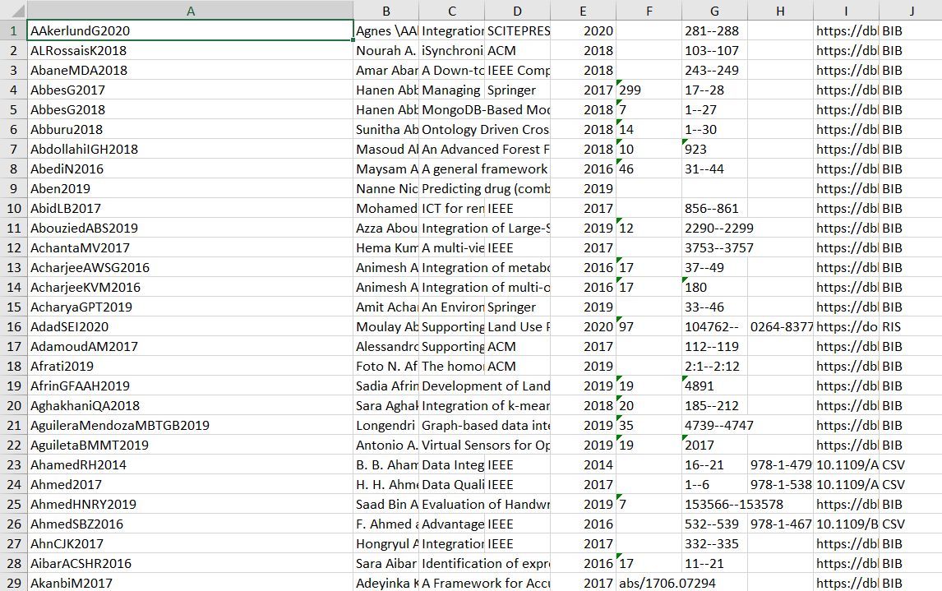
Output in CSV format:

Slide 18
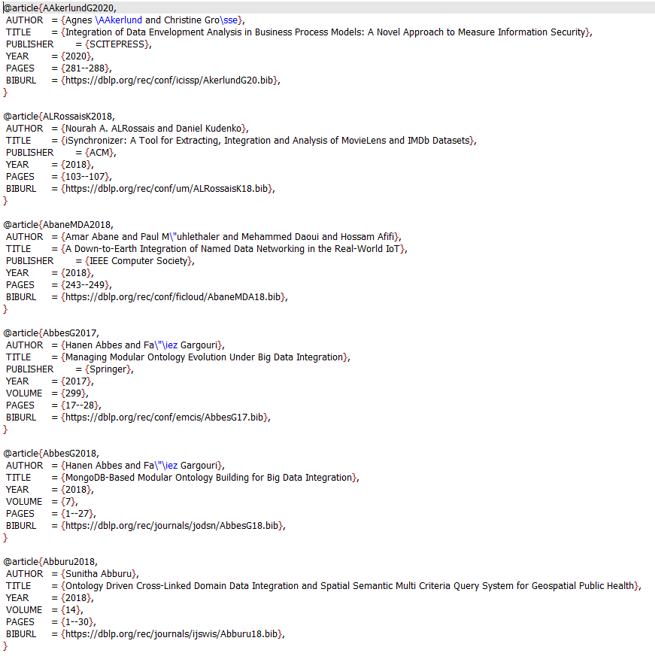
Output in BibTex Format:

Slide 19
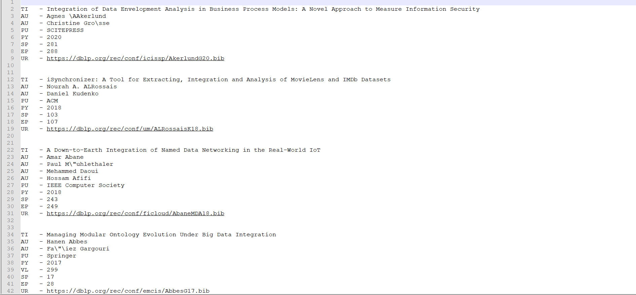
Output in RIS format:

Slide 20
Data Source Reference
IEEE, https://ieeexplore.ieee.org/Xplore/home.jsp
DBLP, https://dblp.uni-trier.de/
ScienceDirect, https://www.sciencedirect.com/

Slide 21


